Slide 1

JavaScript Advanced
Course Overview
SoftUni Team
Technical Trainers
Software University
https://softuni.bg

Slide 2
Table of Contents
Introduction
Training & Team
Course Objectives
Course Organization

Slide 3
Have a Question?
sli.do
#js-advanced

Slide 4












SoftUni Diamond Partners

Slide 5




SoftUni Organizational Partners

Slide 6
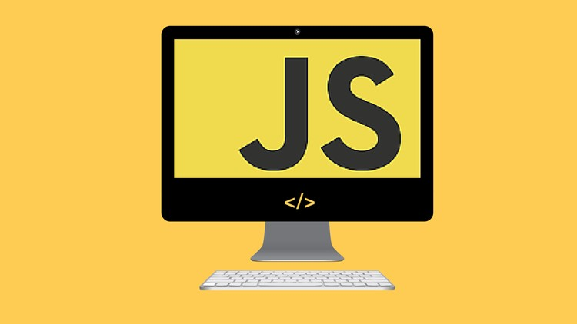
JS Advanced
Course Objectives & Program

Slide 7

JS Advanced – Course Topics
Syntax, Functions and Statements
Arrays
Objects
Advanced Functions - First-class function, higher-order function, partial and currying, IIFE
DOM
DOM Manipulations - Attaching Events, Event Delegaion

Slide 8
JS Advanced – Course Topics
6. JS Classes - Defining classes, structure
7. Unit Testing and Modules - Error handling, exception handling, concepts, mocha
8. Strings and RegExp
9. Workshop

Slide 9

Trainers and Team

Slide 10
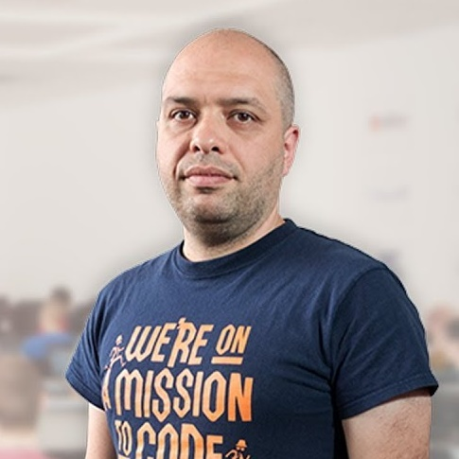

Stamo Petkov
Head Of Department at Information Services Plc.
Worked with various technologies
.NET and C#, BASIC, Pascal, Object Pascal, PHP
More than 15 years of experience
Experienced Lecturer
C# Basics and ASP.NET MVC @ Softuni

Slide 11
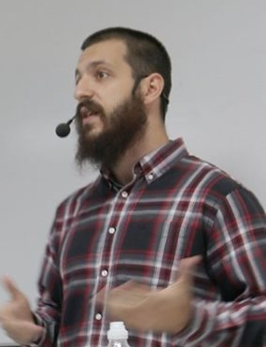
Hristiyan Ivanov
Full-time Front-end developer @Hillgrand
Passionate about JavaScript and Angular
Experienced in:
Public speaking, Javascript, Angular, Node.js, HTML5 …
Bachelor in Economics
Hobbies:
Brazilian Jui Jitsu
Tackling problems on StackOverflow

Slide 12
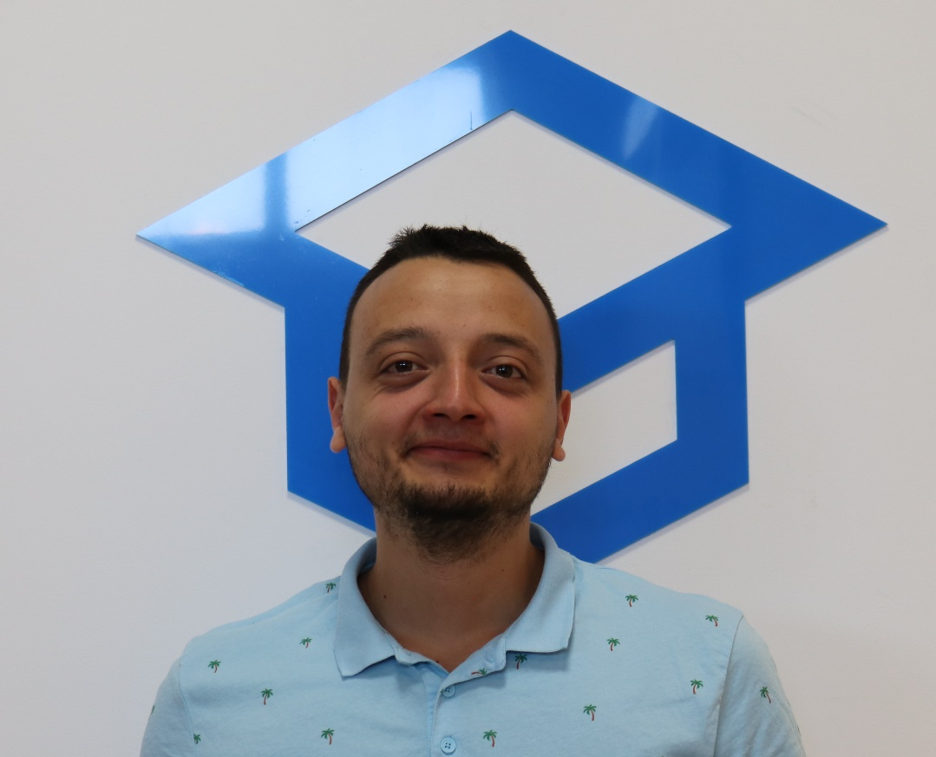
Hristomir Asenov
Team Lead @ JS Web Module
Passionate about JavaScript
Experienced in ExpressJS, ReactJS, MogoDB with Mongoose, HTLM and CSS
Contacts: h.asenov@softuni.bg

Slide 13

Course Details and Schedule
Course Objectives

Slide 14
Targets of the Course
Advanced coding skills for the JS language
Extends the JS Fundamentals course
Covers: Arrays, Objects, Advanced Functions, DOM, Classes, Unit Testing , String Manipulations and RegExp

Slide 15

Practical Exam
Structure: 3 problems for 4 hours
Problems description:
DOM Manipulations
Unit Testing
Classes

Slide 16
Theoretical Exam
20 questions for 30 minutes
Multiple-choice with 1 correct answer
English
Automated quiz system
Available online
You can submit your answers just one time

Slide 17



Scoring System for the Course
Theoretical Exam 5%
PracticalExam 90%
Presence in class 5%
Evaluation
Homework 5 %

Slide 18

Course Organization

Slide 19

Evaluation Criteria
Mandatory
Practical exam - 90%
Theoretical exam - 5%
Exercises/Homework - 5%
Bonuses:
Presence in class – 5% bonus (onsite students only)

Slide 20
Questions?
Notes:
20

Slide 21
Trainings @ Software University (SoftUni)
Software University – High-Quality Education, Profession and Job for Software Developers
softuni.bg, softuni.org
Software University Foundation
softuni.foundation
Software University @ Facebook
facebook.com/SoftwareUniversity
Software University Forums
forum.softuni.bg
Notes:
21

Slide 22

License
This course (slides, examples, demos, exercises, homework, documents, videos and other assets) is copyrighted content
Unauthorized copy, reproduction or use is illegal
© SoftUni – https://softuni.org
© Software University – https://softuni.bg
Notes:
22

